Slide 1
Surveys (Part II)
Week 6 Lecture
Becoming a Political Researcher (POL2017)

Slide 2


Slide 3
Recap
Last week
What are surveys and what are they used for?
Variables and measurement
Designing surveys
Question design
Assessment 1 preparation

Slide 4
What we will cover
This week
Who do we survey? (sampling)
How can we ask questions? (survey mode)
Practical tips for conducting surveys
Primary and secondary data

Slide 5
Survey sampling

Slide 6
Survey sampling
What is sampling
Sampling types
Strengths and weaknesses
Sample size

Slide 7
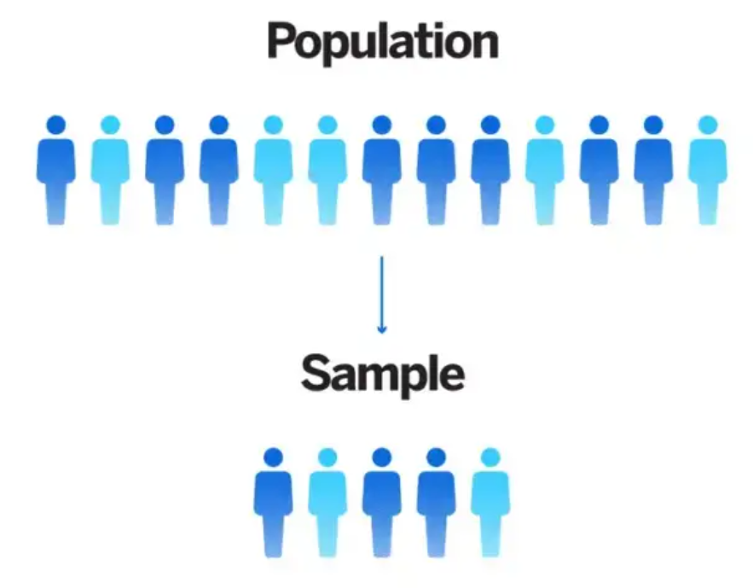
Who to ask?
Survey sampling
Process of selecting a sample of respondents from our population of interest
To do this we need to define our:
Target population
Units of analysis
Sampling frame
Sampling technique

Slide 8
Who to ask?
Who we include in our survey will depend on our research question
Target population
Entire group we are interested in
e.g. UK public, voters, election candidates, African countries

Slide 9
Who to ask?
Units
i.e. sample units/units of analysis
Individual units that make up the population
e.g. individuals, households, schools, constituencies, country

Slide 10
Who to ask?
Sampling Frame
List of members of the population the sample will be drawn from
e.g. Population register, electoral roll, student roll, party members
Sample
Smaller subset of units taken from a larger population

Slide 11
Example: Survey on UK voters’ opinions about Russia’s invasion of Ukraine
Target population
UK voters
Sampling frame
Electoral register
Sample
1000 individuals
Unit
Individual voter
Population
Sampling frame
Sam
Sample
Sample unit

Slide 12
Sources of survey error
Coverage error
Where we choose our sample from
Difference between sampling frame and target population
Sampling error
How we choose our sample
Difference between selected sample and target population
Non-response error
How many people from the sample complete the survey
Difference between selected sample and final responses

Slide 13
Example: Survey on UK voters’ opinions about Russia’s invasion of Ukraine
Coverage error
Does our sampling frame accurately reflect our target population?
Electoral register
Is it up to date?
Is it accurate?
Who might be missing?
Population
Sampling frame
Sam

Slide 14
Example: Survey on UK voters’ opinions about Russia’s invasion of Ukraine
Sampling error
Does our sample accurately reflect our target population?
What sampling technique was used?
Population
Sam
Sample

Slide 15
Sample
Non-response error
Who from our sample actually completed the survey?
Response rates
Are certain groups/individuals more likely to fill in surveys than others?
Are these characteristics randomly distributed among the population?
Completed the survey
Population
Did not complete

Slide 16

Who to ask?
Census
Survey all members of the full target population

Slide 17
Join the Vevox session
Go to vevox.app Enter the session ID: 196-472-727 Or scan the QR code

Slide 18
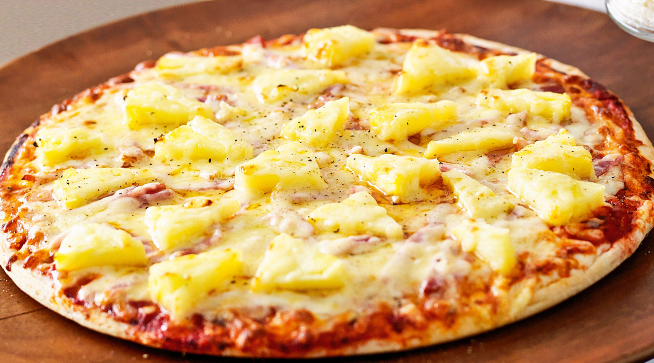
Does pineapple belong on pizza?
##/##
Join at: vevox.app
Question slide
ID: 196-472-727
Yes
0%
No
0%
Unsure
0%

Slide 19
Does pineapple belong on pizza?
##/##
Join at: vevox.app
Results slide
ID: 196-472-727
Yes
##.##%
No
##.##%
Unsure
##.##%

Slide 20
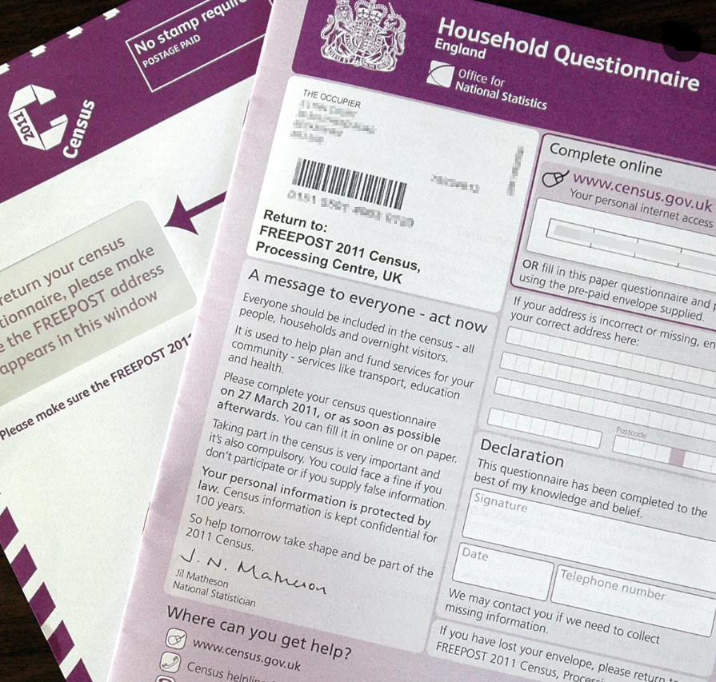

UK Census
Every 10 years
Cost
Planning & organisation
2021 UK Census costs: £900 million

Slide 21
Who to ask?
Alternatives to asking the full population
Probability (random) sampling
Non-probability (non-random) sampling

Slide 22
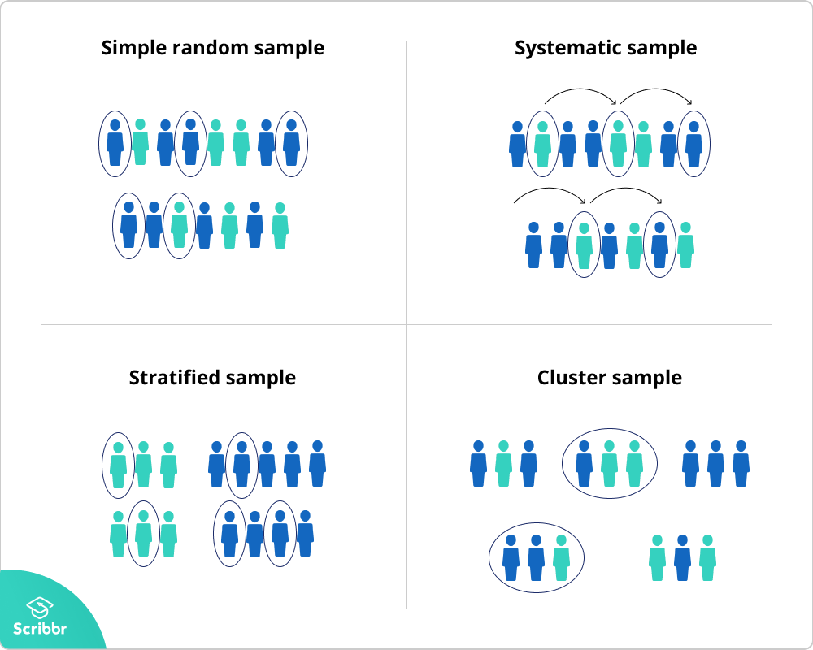
Probability sampling
Sampling types:
Simple random
Systematic
Stratified
Cluster

Slide 23
Probability sampling
Simple random sampling
Assign numbers to full population, then draw numbers randomly
All members of population have a known, equal, non-zero change of selection
May omit or underrepresent certain groups

Slide 24


Examples
National lottery Drawing names from a hat

Slide 25
Probability sampling
Systematic sampling
Skip interval used
Start at random point in list, then select every ‘X’ unit to include in sample
Need to be aware of any patterns in list ordering

Slide 26
Probability sampling
Stratified sampling
Used to try and be more representative across certain features
Divide population into groups
Then use other sampling approach
Sampling frame must have info on strata

Slide 27
Probability sampling
Cluster sampling
Population divided into clusters
Randomly select clusters
Then sample units from selected clusters
Can reduce costs of data collection
Potentially increases sampling error

Slide 28
Discussion question
For the following research question:
What do you think the target population would be?
What type of sampling do think would be most appropriate?
RQ1: Are citizens from rural or urban areas more likely to vote for the Green party in Scottish Parliamentary elections?
Simple, systematic, stratified, cluster

Slide 29
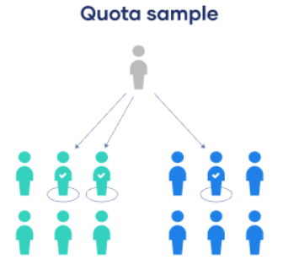
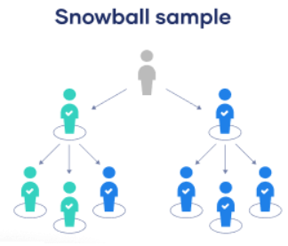
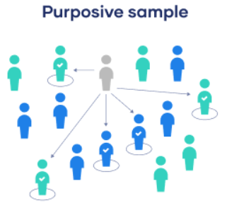
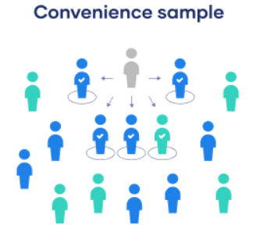
Non-probability sampling
Sampling types:
Quota
Snowball
Purposive
Convenience

Slide 30
Non-probability sampling
Quota sampling
Recruit certain number of respondents from specific groups
Select sub-groups of interest
Decide on quota numbers
Recruit participants until quota reached

Slide 31
Non-probability sampling
Snowball sampling
Recruit initial respondent based on relevant criteria
Respondent suggests other people to be surveyed
Often used for hard to reach populations

Slide 32
Non-probability sampling
Purposive sampling
Use own judgement
Select units you think are typical or representative of the target population

Slide 33
Non-probability sampling
Convenience sampling
Include units who are the easiest to reach
Availability and willingness to participate

Slide 34
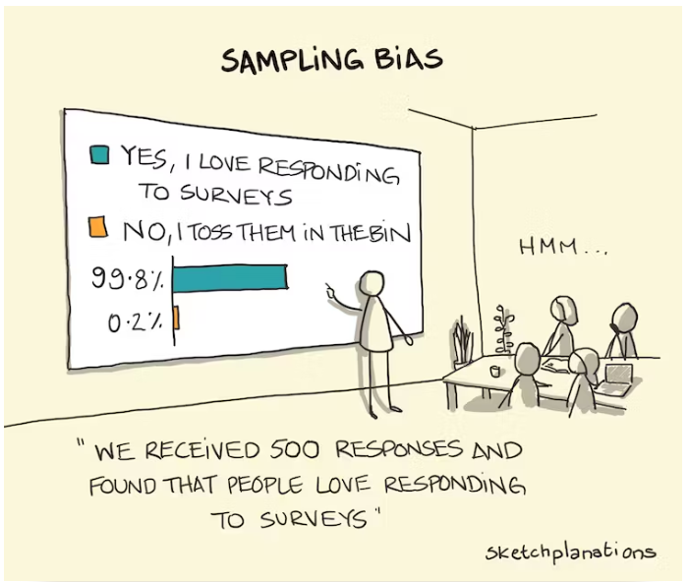

Slide 35
Discussion question
For the following research question:
What do you think the target population would be?
What type of sampling do think would be most appropriate?
RQ2: What motivates people to take part in protests in authoritarian states?
Simple, systematic, stratified, cluster
Quota, snowball, purposive, convenience

Slide 36
Strengths and weaknesses
Probability sampling
Non-probability sampling
External validity
Reduced sampling error
Reduced selection bias
Allows for reliable statistical analysis
Quicker & cheaper
Good for hard to reach populations
Doesn’t need complete sample frame

Slide 37
Sample size
No magic number that always works, context dependent
Trade off between:
Practical limitations vs representativeness and validity
In general: bigger sample size = lower sampling error
But diminishing returns (>1,000 in national surveys)

Slide 38
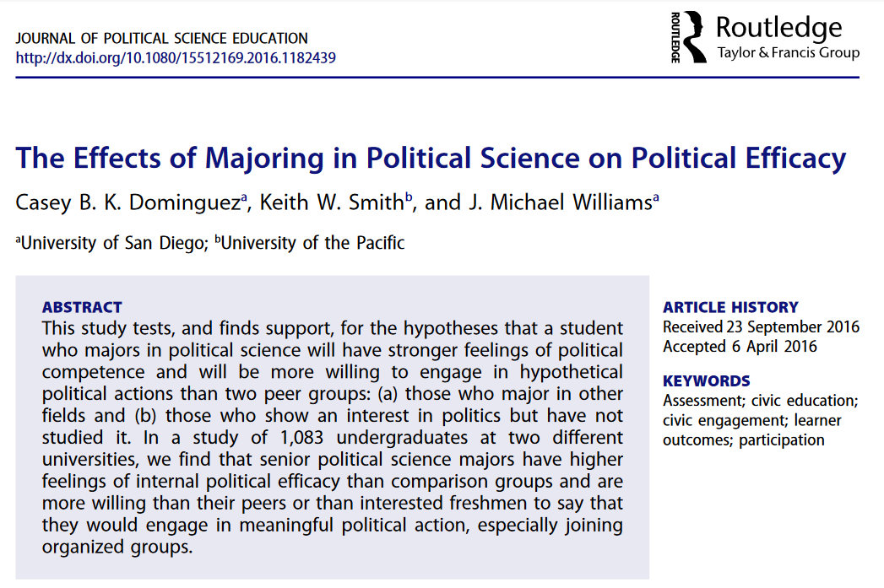
Example (Dominguez et al, 2016)
RQ: Does studying political science affect students’ long-term political behavior?
DV: Political efficacy, political participation
IV: Degree subject,
Year of study

Slide 39
Example (Dominguez et al, 2016)
Sampling
Surveyed 1,083 undergraduate students
From 2 universities in California
Participants recruited via lecturers, who gave surveys during class time
Targeted 1st year and 4th year classes
Students were from 57 different courses
What type/s of sampling was used?
What are potential strengths/limitations of their approach?

Slide 40
Summary
Sampling approach will depend on our research question
We will need to consider our:
Target population
Sampling frame
Sample
Sample Unit

Slide 41
Summary
Sampling should try to minimise:
Coverage error
Sampling error
Non-response error
We can ask questions to our full population (census)
Or use different sampling techniques

Slide 42
Summary
Probability sampling:
Simple random
Systematic
Stratified
Cluster
Non-probability sampling:
Quota
Snowball
Purposive
Convenience

Slide 43
Summary
Sample size
Ideal sample size is context dependent
Bigger samples can help reduce sampling error
Bigger sample may be needed for sub-group analysis
But diminishing returns after certain point
Trade off between practical limitations vs representativeness

Slide 44
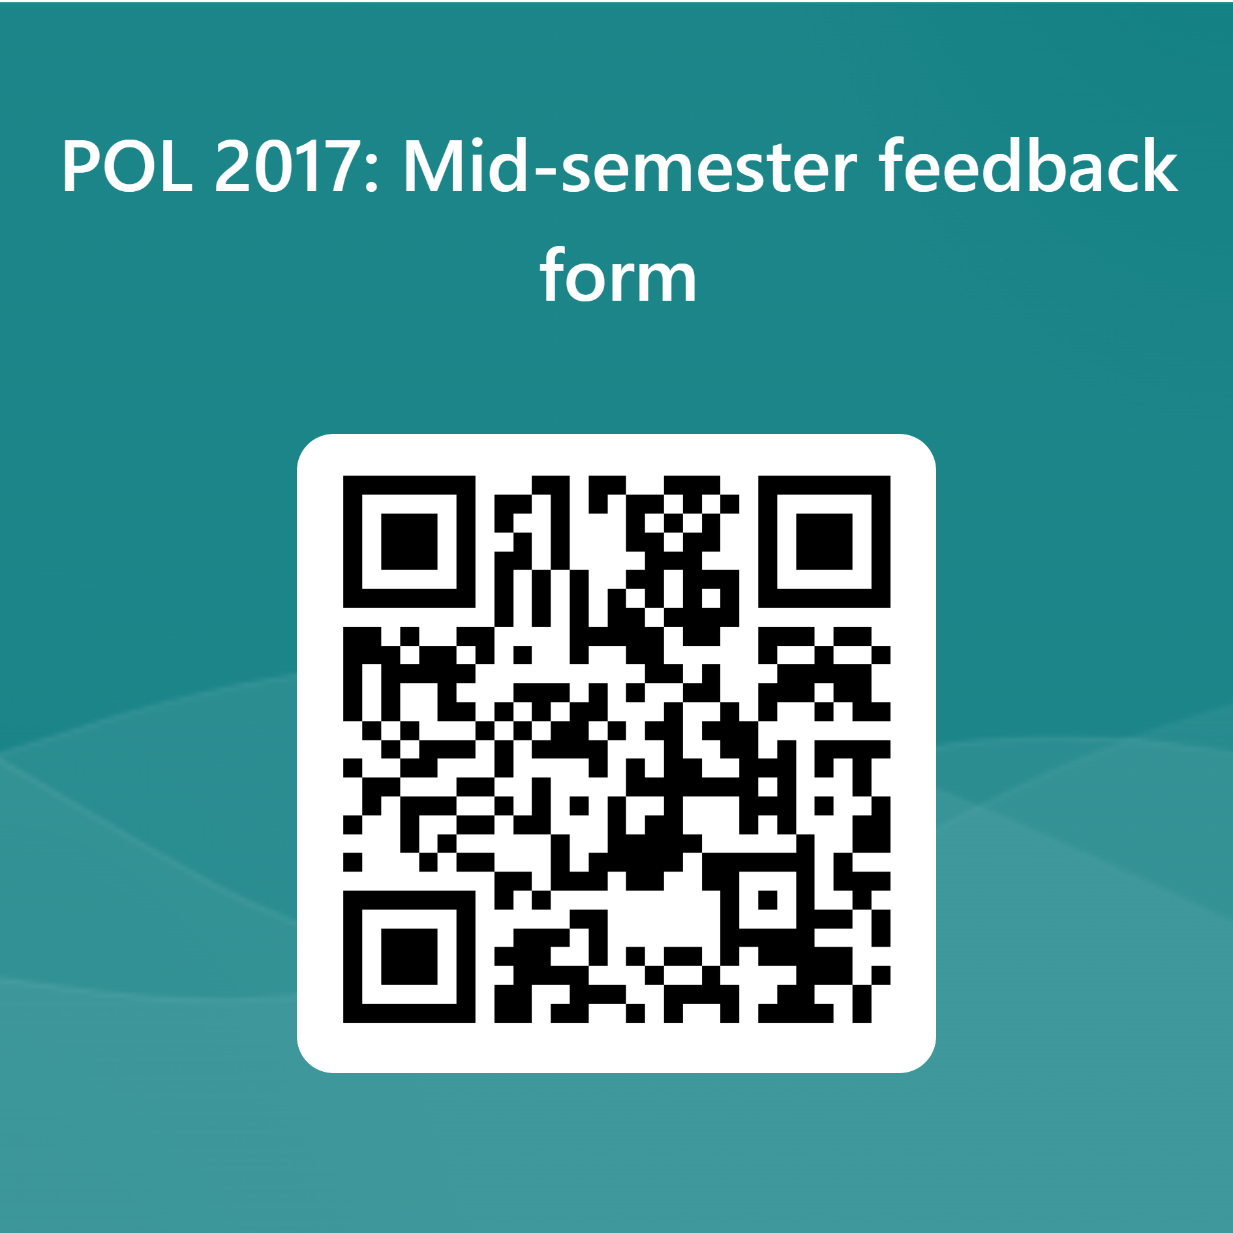
Link to form: https://forms.office.com/e/LWjRH91MVJ

Slide 45
Survey mode

Slide 46
How we ask questions
Range of ways we can ask survey questions:
Face to face surveys
Telephone surveys
Postal surveys
Internet surveys

Slide 47
How we ask questions
The format in which we ask our questions can impact:
Measurement error
How people answer our questions
Sampling error
Who answers questions

Slide 48

Face to face surveys
Conducted in person
Interviewer asks respondent pre-set questions
Structured interview
Still the gold standard, but costly to run

Slide 49

Telephone surveys
Interviewer asks preset questions over the phone
Can access remote locations easily
Can’t use visual cues

Slide 50


Mail and Online Surveys
Postal surveys, online surveys
Self completion questionnaires, respondent fills out themselves
Cheap to run
Online panels often used
Combination of volunteer and quota sampling

Slide 51
Which mode to choose?
Cost
Sampling frame
Comprehension problems
Interviewer effects
Coverage/sampling error
Non-response

Slide 52
Discussion Question
Lets say we are conducting a research project on the topic of:
Topic 1: How have energy price increases impacted British pensioners’ quality of life?
What survey mode do you think would be best suited to our project, and why?
Face to face, telephone, post, online

Slide 53
Discussion Question
Lets say we are conducting a research project on the topic of:
Topic 2: How often do young people living in remote areas discuss politics with friends online?
What survey mode do you think would be best suited to our project, and why?
Face to face, telephone, post, online

Slide 54
Summary
The format in which we ask our questions can impact:
Measurement error
How people answer our questions
Sampling error
Who answers questions
Survey modes:
Face to face surveys
Telephone surveys
Postal surveys
Internet surveys

Slide 55
Summary
When deciding on survey mode, we should consider:
Cost
Sampling frame
Comprehension problems
Interviewer effects
Coverage/sampling error
Non-response

Slide 56
Running our own surveys

Slide 57
Primary data collection
Primary data
Original data collected first-hand by the researcher
Considerations
Research ethics
What to ask (last week)
Who to ask (sampling)
How to ask (mode)

Slide 58
Ethics
Potential harms of our research
Sensitive topics, context of participation
Informed consent
Voluntary participation
Privacy
Anonymity, confidentiality, identification, data security

Slide 59
Creating surveys
Huge variety of tools we can use:
Google forms
Survey monkey
Qualtrics
Pay for panel sample
Submit questions to ongoing surveys

Slide 60
Creating surveys
Survey questions
Need to make sure we include questions about our key variables
Often also want demographic information
e.g. age, gender, location, education
Can offer incentives to try and reduce non-response
Follow-up messages to respondents

Slide 61
Primary survey data
Strengths
Can decide exactly what questions are included
Control over sampling process
Control over timing of fieldwork
Can explore new research areas
Limitations
Can be costly to run
May be difficult to recruit sample
Representativeness
Time needed for fieldwork

Slide 62
Using secondary survey data

Slide 63
What can we do with survey data?
Secondary data
Use existing data collected by someone else, which you will then report, analyse or interpret
For many research questions, there may already be survey data out there
Can use data others have collected
Can merge different datasets

Slide 64
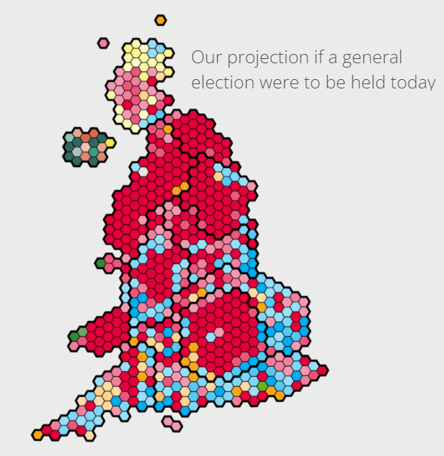
What can we do with survey data?
We can use survey data for:
Description
Explanation
Prediction
Statistical analysis
Data visualisation
Combine with other types of data

Slide 65
Where to find survey data?
Official statistics
Post-election surveys
Attitude surveys
Regional barometers
Public opinion polling
Useful list of politics datasets:
PolData

Slide 66
Secondary survey data
Strengths
Cheap and quick
Range of places and times
Commonly used questions
Often high-quality
Big samples
Limitations
May not be focused on your research topic
Stuck with questions that were asked
Trust that sampling and execution done correctly
Is documentation available?
May be out of date

Slide 67
Assessment 1

Slide 68
Assignment referencing
Blackstone (2012) online book
No page numbers included
Can cite as a webpage (Cite them right) with a link to the chapter

Slide 69
Single chapter
In text citations
Point from first chapter (Blackstone 2012).
Reference list
Blackstone, (2012) Principles of Sociological Enquiry, Chapter 2: Linking Methods with Theory, Available at:https://saylordotorg.github.io/text_principles-of-sociological-inquiry-qualitative-and-quantitative-methods/s05-linking-methods-with-theory.html, (Accessed: 04/03/24)

Slide 70
Multiple chapters
In text citations
Point from first chapter (Blackstone 2012a). Point from second chapter (Blackstone 2012b).
Reference list
Blackstone, (2012a) Principles of Sociological Enquiry, Chapter 2: Linking Methods with Theory, Available at:https://saylordotorg.github.io/text_principles-of-sociological-inquiry-qualitative-and-quantitative-methods/s05-linking-methods-with-theory.html, (Accessed: 04/03/24)
Blackstone, (2012b) Principles of Sociological Enquiry, Chapter 8: Survey Methods, Available at:https://saylordotorg.github.io/text_principles-of-sociological-inquiry-qualitative-and-quantitative-methods/s05-linking-methods-with-theory.html, (Accessed: 04/03/24)

Slide 71
Assignment 1
Any questions about the first assessment?

